Slide 1

Boon or Bust? A Classical Liberal Perspective on the Labor Market Impact of AI
Justin Callais, Archbridge Institute
Nicholas Thielman, R Street Institute
This Version: May 2026

Slide 2


Who We Are
R Street Institute is a nonprofit, nonpartisan public policy research organization. Our mission is to engage in policy research and outreach to promote free markets, and limited government.

Slide 3
01
Review of AI’s current labor market impact
What’s Ahead
02
Macroeconomic projections of AI’s impact
03
Historical Analogues
04
The emerging state-level framework for AI
05
Potential policy solutions
06
Conclusion & Open Forum

Slide 4

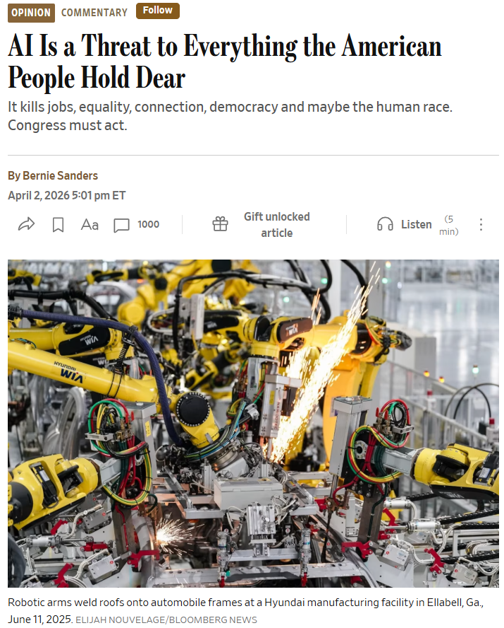
Artificial Intelligence: Top of mind for politicians
R STREET
In light of Congressional inaction, the AI governance framework has started to emerge in a piecemeal manner at the state-level.
As of March 2026 over 1,500 AI-related bills have been introduced across 45 states (Multistate AI 2026).
Much of this legislation is premised on concerns over “AI Risk,” and specifically the impact that AI will have on labor markets.
Everything from banning the use of AI in certain professions to moratoria on the construction of data centers have been called for.

Slide 5
What is the consensus of the academic and policy literature with regard to the labor market impact of AI?
What is the likely impact of AI on labor markets? Are there any historical analogues?
What kind of institutional framework is most conducive to navigating the AI transition?
Key Questions

Slide 6

Framework: Public Choice & NIE
R STREET
“Institutions are the humanly devised constraints that structure human interaction. They are made up of formal constraints (rules, laws, constitutions), informal constraints (norms of behavior, conventions, and self imposed codes of conduct), and their enforcement characteristics.”
— Douglass North (1993)
Public Choice: The application of the models and theorems of economics to the study of political behavior.
New Institutional Economics (NIE): analyzes how institutional rules affect transaction costs and economic performance.

Slide 7

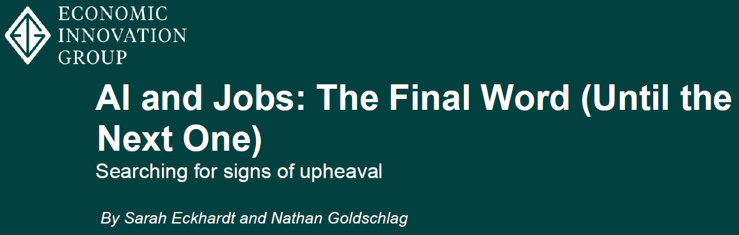
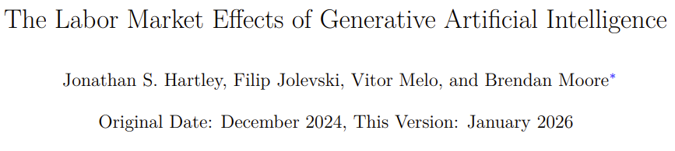
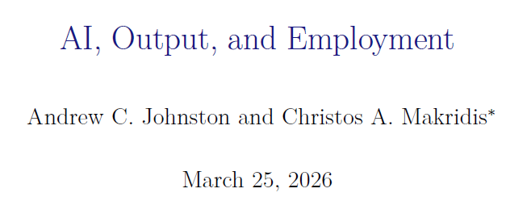
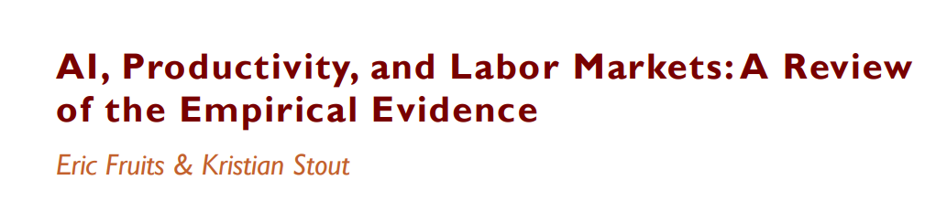
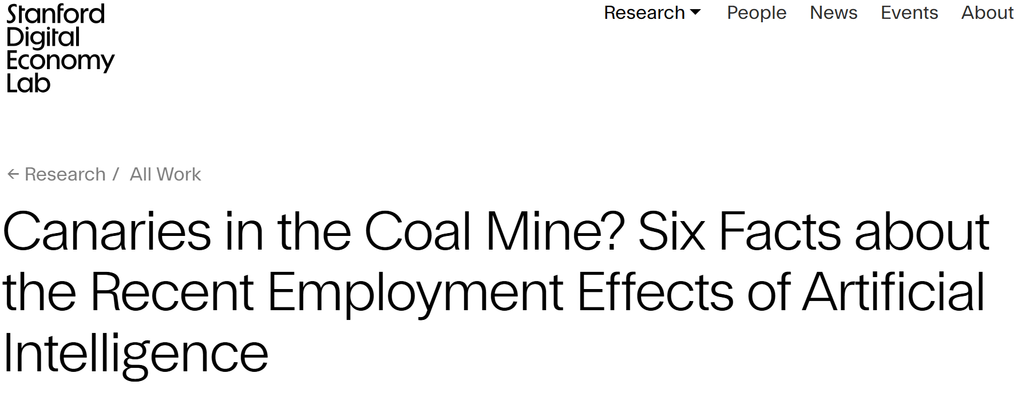
What are the Current Labor Market Effects of AI?
Aggregate labor market disruptions have been minimal since the introduction of AI in 2022 (Fruits and Stout 2026; Chandar 2025).
Stanford researchers found that, in AI-exposed occupations, entry-level employees experienced a 16% decline in employment, controlling for other factors (Brynjolfsson, Chandar, and Chen 2025).
Evidence of displacement seems to depend on the data set being analyzed.

Slide 8
What are the Current Labor Market Effects of AI? (Contd.)
Johnston and Makridis (2026) find that in highly-exposed occupations where AI augments rather than substitutes for human labor, workers experienced both employment and wage gains.
A one standard deviation increase in AI exposure increases sector output by 7-10% and employment by 4%, where it complements human labor.
No significant employment effects in occupations where AI can substitute for labor.
Bonney et al. (2026) found that approximately 66% of respondents use AI to augment tasks, and that AI-related employment decreases occur in only 2% of firms.
OLS results indicate that enterprise-level investment in AI is positively associated with employment declines.

Slide 9
Experimental Evidence and Surveys
Hartley et al. (2026) using a mix of survey and diff-in-diff techniques find that AI triples the productivity of workers who use it at work. They also show that in highly-exposed professions, AI has led to small wage gains, while employment is largely unchanged.
Evidence from controlled experiments consistently finds that AI improves worker productivity, and improves the quality of outputs, with these effects being particularly significant for lower-skilled or junior workers. Some studies also find evidence of wage gains as a result of these improvements (Fruits and Stout 2026).
Results hold for both task and firm-level experiments.
Proper verification procedures have proven important.

Slide 10
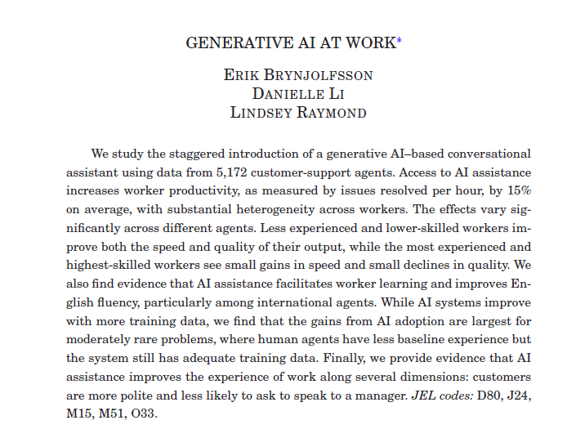

Slide 11
In sum…
Overall, both statistical and survey-based studies indicate that AI-driven displacement has been minimal.
Existing literature points to AI having heterogeneous effects on labor, depending on whether AI complements or substitutes for human effort. Not just a story of uniform displacement.
AI has been shown to yield both productivity gains and improvements in output quality. These have translated into wage and employment gains in some cases.
Literature continues to evolve, as does AI. Some displacement will likely occur.

Slide 12
What are the Projected Macro Effects of AI?
Daron Acemoglu (2025) estimated that AI will likely only increase total-factor productivity (TFP) by about 0.66% and GDP by approximately 1.1-1.6% over the 10 year horizon.
Using a similar framework, Alexander Arnon (2025) at the Penn Wharton Budget Model projects that AI will increase TFP and GDP by approximately 1.5% by 2035, nearly 3% by 2055, and 3.7% by 2075.
Ezra Karger et al. (2026) synthesize expert forecasts, finding that the median respondent expects annual GDP growth rate of 2.5% and small declines in labor force participation by 2030. Above medium- and long-term forecasts.

Slide 13

What are the Projected Macro Effects of AI? (Contd.)
Consultancies and banks forecast even stronger AI impacts on productivity and growth.
Briggs and Kodnani (2023)
Global GDP is projected to rise by 7% (~$7 trillion) over 10 years.
300 million jobs potentially exposed to automation. Historically, job creation has outweighed destruction.
Erdem and Birur (2025)
Rapid Adoption Scenario:
+$2.48 trillion to US GDP by 2030.
+$3.37 trillion to US GDP by 2050.
+8.06 million jobs by 2050.

Slide 14
In sum…
Current projections of the macroeconomic effects of AI vary according to assumptions about model capabilities and rate of diffusion.
Most likely, AI will boost TFP and GDP by around 1-2% over the 10 year horizon.
Factors impacting when and the magnitude of AI’s macro-impact:
Complementary investments
Policy Uncertainty
Will return to the second point later.

Slide 15
Are there useful analogues?
R STREET
The Difficulties of Comparison
At the cutting edge, AI represents generalized intelligence. In this regard, it is historically unprecedented and the implications for economy and society are broadly uncertain.
Historical Analogues
Agriculture
The mechanization of agriculture in the early- to mid-20th Century.
Finance
Information revolution in finance.

Slide 16
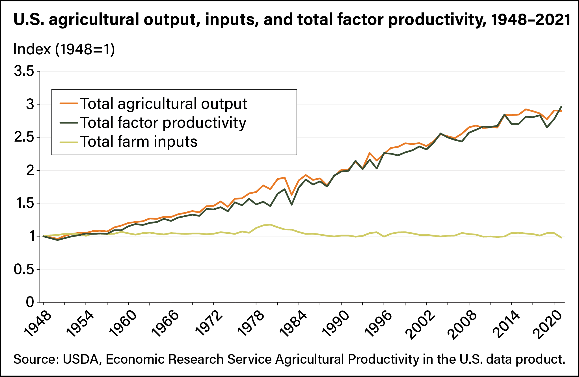
The Productivity Revolution in Agriculture
In the early 1900s ~40% of the U.S. labor force worked in agriculture, now 1.2% (Fisk 2001).
Primarily driven by scientific advances in cultivation and mechanization (i.e., tractors).
TFP massively increased, yet no mass unemployment. Displaced labor transitioned into new roles in the burgeoning urban economy.

Slide 17
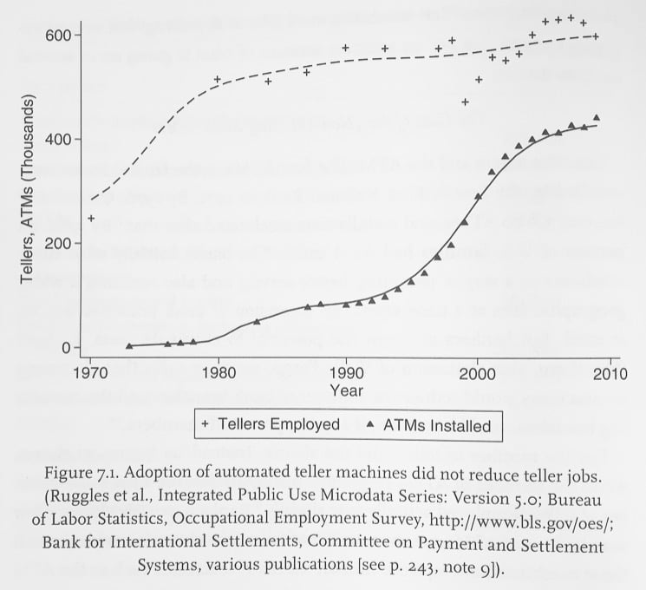
ATMs in Banking
The advent of the information revolution in banking, and specifically the introduction of automated-teller machines, was expected to eliminate the need for bank tellers.
ATMs reduced the number of tellers per branch, lowering the marginal cost of a new branch office.
As a result, banks started opening more branches starting in the 1980s, increasing demand for tellers by more than the efficiency gains from ATMs (Bessen 2016).

Slide 18
What is the Through Line?
The development and diffusion of the technologies underlying these transformations occurred without government attempting to engage in preemptive regulation.
In the case of agriculture, government involvement was primarily “enabling” rather than restrictive.
Firms and entrepreneurs were generally free to invest in these new technologies where this was economically viable.
Factor markets, particularly labor markets, were able to shift displaced workers to new roles or sometimes regions where their services had a higher value.
The same will be true for AI: Institutions will be determinative in how AI’s labor impact will be felt and, importantly, whether “scarring” occurs.

Slide 19
The Emerging AI Governance Framework
R STREET
The problem is not state action per se, but prescriptive state regulation of AI development and deployment specifically.
California, Texas, and New York have emerged as leaders, enacting 20, 12, and 10 bills, respectively, in 2025 alone (Stanford HAI 2026).
Much of this legislation aims to put fences around the deployment of AI or place prescriptive guardrails around its actual development (Thierer and Kolas 2026).
Examples:
Algorithmic discrimination safeguards in Colorado.
Nevada and Illinois’ ban on using AI in mental healthcare.
New York SB 7263 - bar the use of AI in providing legal advice.

Slide 20
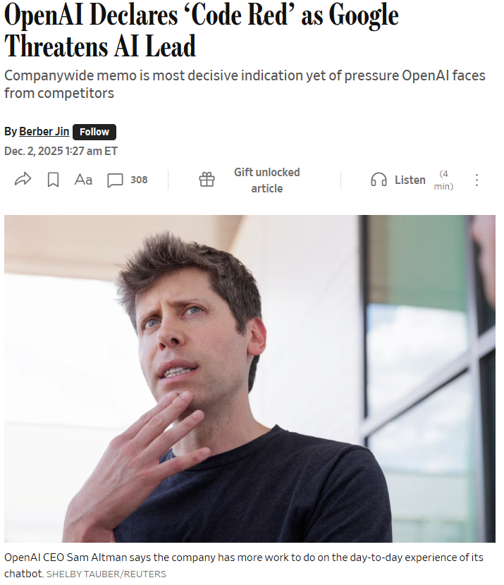
Problems with the Patchwork: Rent-Seeking
R STREET
Public concerns over the Labor Market impact of AI, or its other societal impacts, naturally lend themselves to “Bootlegger and Baptists”-style capture.
Intense competition in the Generative AI marketplace may provide an impetus for efforts to “raise rivals costs” (Thielman 2026).
~80% decline in quality-adjusted prices for AI; a boon for consumers (André, Bétin, and Gal 2025).
Preserving competitive markets will be key in driving productivity gains.

Slide 21
Problems with the Patchwork: The Patchwork Problem
R STREET
So what?
AI systems are highly interconnected. The development and training of models involves input contracts and outputs that are not geographically restricted.
Conforming to each state’s different framework would create a substantial compliance burden for firms and increase transaction costs. Even if “best” governance framework were selected (Ford 2025).
For example, having to create different contractual arrangements to adhere to state data privacy rules.

Slide 22
Problems with the Patchwork: The “Sacramento-Albany” Effect
R STREET
Due to their sheer economic size California, New York and Texas would effectively be able to set policy for the rest of the country (Huddleston 2024; Frazier and Thierer 2025)
AI developers or users hoping to achieve nationwide distribution or scale would be required to comply with these state frameworks.
Thus attempts at rent-seeking in one of these states could impose costs on firms and users operating beyond state boundaries.
Big firms could absorb these, could potentially drive out smaller firms and become a barrier to entry for nascent entrepreneurs.

Slide 23
Problems with the Patchwork: Inertia and Pacing Problems
R STREET
Once in place, regulations tend not to change. Very little incentive for elected officials to alter them as the gains from deregulation are diffuse and the costs concentrated.
Incumbent firms face the transitional gains trap; protected firms become hot-house flowers.
It is not clear that these issues can be ameliorated via competitive federalism.

Slide 24
Institutional Solutions to Technological Problems
R STREET
Key Claim: States that provide entrepreneurs greater latitude to invest in and develop AI applications will be better positioned to capture the technology's productivity gains. Likewise, ensuring that labor market institutions are flexible will help mitigate the downsides.
The connection between economically free institutions and improvements in human welfare holds both cross-nationally and at the subnational levels…
…and for technological innovation as well, “It seems that as a general rule, then, the weaker the government, the better it is for innovation.” (Mokyr 1990)
Moreover, economic freedom tends to “soften the blow” of economic shocks as well, making those jurisdictions more resilient (Callais and Pavlik 2023; Bjørnskov 2016).
Given this, we have no strong theoretical reason to expect AI to be an exception to this pattern.

Slide 25
Free Labor Markets
Labor market scarring and other distributional effects are not the product of shocks or innovations themselves, but rather with how these interact with local and state-level labor market institutions (Stout 2025).
Concerning automation, recent empirical work found that licensure deregulation mitigates more than 90% of the negative effects of a one standard deviation increase in automation exposure on income mobility, depending on the measure used (Geloso, Plemmons, and Sharma 2026).
Licensing laws reduce the ability of workers to pivot into new roles (Kleiner and Xu 2025).
Occupational licensure reform is therefore a necessary complement to AI adoption; restricting entry into new roles compounds displacement effects of technological change.

Slide 26
More Generally, Do No Harm
AI is not “unregulated.” Its development and diffusion remain subject to consumer protection, antitrust, and civil rights law, among other generally applicable laws.
Utah’s regulatory sandboxes or Montana’s “Right to Compute Laws” are all steps in the right direction.
Federal preemption of extraterritorial state laws is warranted, though a federal framework risks replicating the same problems at a larger scale.
Private governance of AI provides a potential third option (Ball 2025; Hadfield and Clark 2026).

Slide 27
Conclusion
The empirical literature on the labor market impact of AI indicates that fears about mass technological unemployment are, at the moment, overstated.
Labor market effects are conditional on whether AI complements or substitutes for human effort. Displacement has mostly been restricted to early-career employees in highly-exposed occupations, involving tasks that are easily “automatable.” Some degree of displacement will likely occur.
Regional effects and adaptation will be contingent upon the degree to which state-level institutions allow resources to flow to highest-use. That is economic freedom is key.

Slide 28


Open Forum
Any questions?

Slide 29
Works Cited
R STREET
Acemoglu, Daron. "The Simple Macroeconomics of AI." Economic Policy 40, no. 121 (January 2025): 13–58. https://doi.org/10.1093/epolic/eiae042.
André, Christophe, Manuel Bétin, and Peter Gal. "Dynamism in Generative AI Markets since the Release of ChatGPT." VoxEU/CEPR, July 12, 2025. https://cepr.org/voxeu/columns/dynamism-generative-ai-markets-release-chatgpt.
Arnon, Alexander. "The Projected Impact of Generative AI on Future Productivity Growth." Penn Wharton Budget Model, September 8, 2025. https://budgetmodel.wharton.upenn.edu/p/2025-09-08-the-projected-impact-of-generative-ai-on-future-productivity-growth/.
Ball, Dean W.. “A Framework for the Private Governance of Frontier Artificial Intelligence.” ArXiv abs/2504.11501 (2025): n.p. https://doi.org/10.48550/arXiv.2504.11501.
Bessen, James. Learning by Doing: The Real Connection between Innovation, Wages, and Wealth. New Haven, CT: Yale University Press, 2015.
Bjørnskov, Christian. "Economic Freedom and Economic Crises." European Journal of Political Economy 45, (2016): 11-23. https://doi.org/10.1016/j.ejpoleco.2016.08.003.
Bonney, Kathryn, Cory Breaux, Emin Dinlersoz, Lucia Foster, John Haltiwanger, and Aditya Pande. "The Microstructure of AI Diffusion: Evidence from Firms, Business Functions, and Worker Tasks." CES Working Paper No. CES-26-25. Washington, DC: U.S. Census Bureau, Center for Economic Studies, April 2026. https://www.census.gov/library/working-papers/2026/adrm/CES-WP-26-25.html.

Slide 30
Works Cited
R STREET
Brynjolfsson, Erik, Bharat Chandar, and Ruyu Chen. “Canaries in the Coal Mine? Six Facts about the Recent Employment Effects of Artificial Intelligence.” Working paper, Stanford Digital Economy Lab, November 2025. https://digitaleconomy.stanford.edu/publication/canaries-in-the-coal-mine-six-facts-about-the-recent-employment-effects-of-artificial-intelligence/.
Callais, Justin T. and Jamie Pavlik. “Does economic freedom lighten the blow? Evidence from the great recession in the United States.” Economics of Governance 24, 357–398 (2023). https://doi.org/10.1007/s10101-022-00283-0.
Chandar, Bharat. “AI and Labor Markets: What We Know and Don’t Know.” Stanford Digital Economy Lab, October 10, 2025. https://digitaleconomy.stanford.edu/news/ai-and-labor-markets-what-we-know-and-dont-know/.
Erdem, Erkan, and Dileep Birur. "Generative AI and Economic Growth: A New Approach to Measuring Its Potential Impact." KPMG, November 2025. https://kpmg.com/us/en/articles/2025/generative-ai-economic-growth.html.
Fisk, Donald M. "American Labor in the 20th Century." Compensation and Working Conditions, Fall 2001. U.S. Bureau of Labor Statistics. Originally posted January 30, 2003. https://www.bls.gov/opub/mlr/cwc/american-labor-in-the-20th-century.pdf.
Ford, George S. "An Economic Argument for Federal Preemption of State AI Laws." Phoenix Center Perspectives No. 25-05. Phoenix Center for Advanced Legal and Economic Public Policy Studies, November 6, 2025. https://www.phoenix-center.org/perspectives/Perspective25-05Final.pdf.

Slide 31
Works Cited
R STREET
Briggs, Joseph, and Devesh Kodnani. "The Potentially Large Effects of Artificial Intelligence on Economic Growth." Goldman Sachs Global Investment Research, March 26, 2023. https://www.gspublishing.com/content/research/en/reports/2023/03/27/d64e052b-0f6e-45d7-967b-d7be35fabd16.html.
Geloso, Vincent, Alicia Plemmons, and Pradyot Sharma. "Income Mobility, Automation, and Occupational Licensing." Southern Economic Journal, 2026. https://doi.org/10.1002/soej.70037.
Hadfield, Gillian K., and Jack Clark. “Regulatory Markets: The Future of AI Governance.” Jurimetrics: The Journal of Law, Science and Technology 65 (Winter 2026): 195–240. https://doi.org/10.48550/arXiv.2304.04914.
Hartley, Jonathan, Filip Jolevski, Vitor Melo, and Brendan Moore. "The Labor Market Effects of Generative Artificial Intelligence." Working paper, December 18, 2024. Last revised January 25, 2026. https://dx.doi.org/10.2139/ssrn.5136877.
Huddleston, Jennifer. "AI Could Become the Next Victim of the 'Sacramento Effect.'" Reason, June 7, 2024. https://www.cato.org/commentary/ai-could-become-next-victim-sacramento-effect.
Fruits, Eric and Kristian Stout. “AI, Productivity, and Labor Markets: A Review of the Empirical Evidence.” ICLE Issue Brief 2026-02-05. International Center for Law & Economics, February 5, 2026. https://dx.doi.org/10.2139/ssrn.6323960.
Johnston, Andrew C., and Christos A. Makridis. "AI, Output, and Employment." Working paper, March 23, 2026. https://ssrn.com/abstract=6460358.

Slide 32
Works Cited
R STREET
Karger, Ezra et al., "Forecasting the Economic Effects of AI." NBER Working Paper No. 35046, April 2026. https://doi.org/10.3386/w35046.
MultiState. “Artificial Intelligence (AI) Legislation Tracker 2026: All 50 States.” Accessed May 13, 2026. https://www.multistate.ai/artificial-intelligence-ai-legislation.
Kleiner, Morris M., and Ming Xu. "Occupational Licensing and Labor Market Fluidity." Journal of Labor Economics 43, no. 3 (July 2025): 937-982. https://doi.org/10.1086/730120.
Stanford University Human-Centered AI Institute. "Policy and Governance." Chapter 8 in 2026 AI Index Report. Stanford, CA: Stanford HAI, 2026. https://hai.stanford.edu/ai-index/2026-ai-index-report/policy-and-governance.
Kristian Stout, “AI’s Labor Impact Will Emerge from the Institutions that Govern Its Use.” Truth on the Market, December 08, 2025. https://truthonthemarket.com/2025/12/08/ais-labor-impact-will-emerge-from-the-institutions-that-govern-its-use/.
Thierer, Adam, and Kevin Frazier. "Congress Should Lead on AI Policy, Not the States." Law360, February 4, 2026. https://www.law360.com/articles/2434753/congress-should-lead-on-ai-policy-not-the-states.
Thierer, Adam, and Logan Kolas. "The AI Terrible Ten: The Worst State AI Policies and Four Better Models to Balance Safety and Innovation." R Street Institute and American Consumer Institute, March 2026. https://www.rstreet.org/research/the-ai-terrible-ten-the-worst-state-ai-policies-and-four-better-models-to-balance-safety-and-innovation/.
Thielman, Nicholas. "Bootleggers, Baptists, and AI." Fusion, April 2, 2026. https://fusionaier.org/2026/bootleggers-baptists-and-ai-risk/.

