Slide 1

Electricity Affordability: How are States Responding?
Midwest Governors Association
April 7, 2026

Slide 2
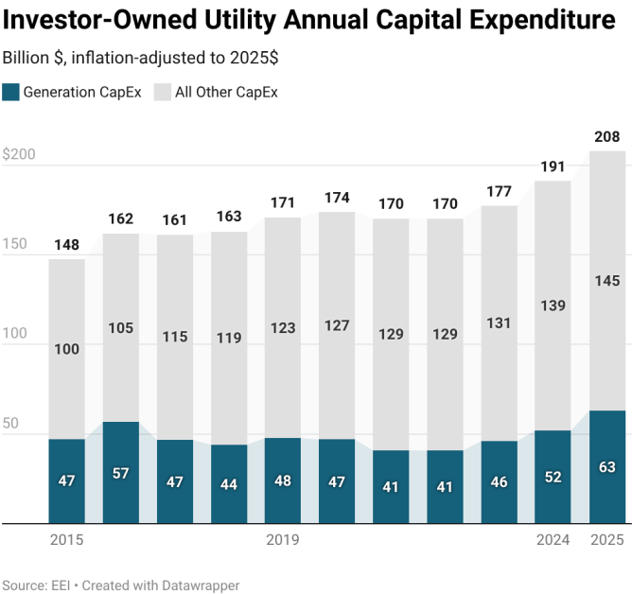
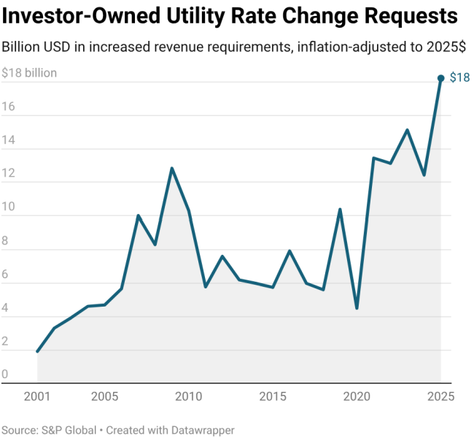
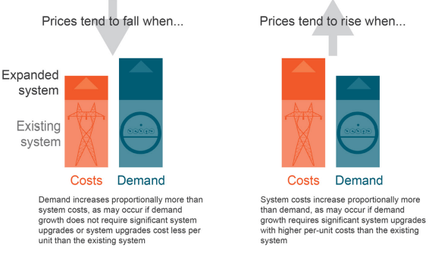
Policy Goals
Back to basics
Least cost, reliable service
Allocation: beneficiary pays/ cost causation
Risk management
Avoid mistakes (e.g., rate freezes)
Economic conditions
Aging, saturated infrastructure
Demand shock: validate forecasts!
Supply crunch: lower artificial costs
Supply chain backlogs
Inefficient status quo regulation
Sources: LBNL retail price trends 2026.

Slide 3
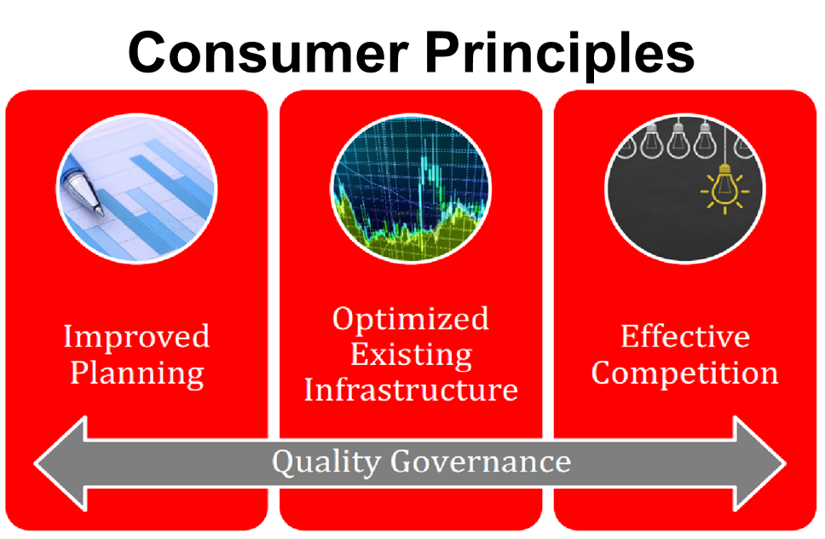
Transmission
Uneconomic Transmission BAU
CoS incentive + siting bias = local Tx project overbuild & inter/regional underbuild
>90% projects: no prudence review or competition
Planning & cost allocation
Cost vs. cost savings (i.e., econ benefits)
MISO complaint lessons
O1920 compliance
Local project oversight
Advanced technologies
Bottom-up RTO stakeholders
Indep. evaluation, IMM role?
Competition
No in-service delay evidence
Cost/risk advantage
Sources: R Street customer transmission agenda (2022) and update (2026). R Street transmission cost drivers & policy remedies DOE/NEDC briefing. Customers’ transmission complaint before FERC.

Slide 4
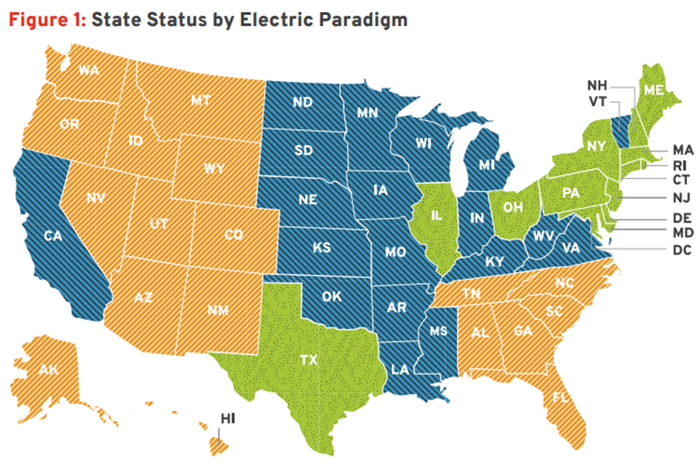
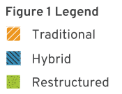
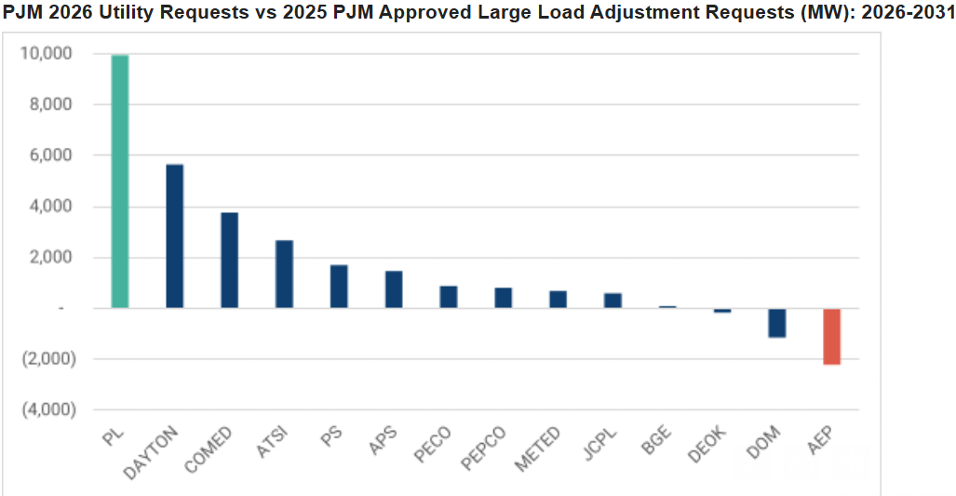
Wholesale
MISO
Coordinate utility planning
PJM
Price cap < new entry cost
IOU costlier than market
Supplemental auction uncertainty
Wholesale-retail compatibility
Fix forecasts! (retail roots, RTO validate)
Utility IRP and IPP mixtures
Capacity market vs. retail hedging periods
Sources: R Street Paradigms paper (2023), PJM & Jeffries LLC (2025), R Street PJM forecasts analysis (2026), E3 (2025): Balancing Risk and Growth,

Slide 5
Retail
R Street Retail Scorecard
N. Dakota (D) | Nebraska (N/A) | Illinois (B+) | Minnesota (D-)
S. Dakota (D) | Missouri (D) | Indiana (D) | Ohio (B+)
Kansas (D+) | Wisconsin (D-) | Iowa (D) | Michigan (C)
CoS states: large load tariffs vs. C&I market access
2025: PUCs approved 29 large load tariffs
C&I market push (e.g., MO, IN, MI, IA, WI)
Competitive states: implement better
E.g., default service auctions
Remove cross-subsidies e.g., Ohio HB 15
Likely BAU upgrade
Superior cost, risk, & speed profile
Sources: R Street 2025 retail scorecard, 2026 MO analysis, and IN analysis

Slide 6
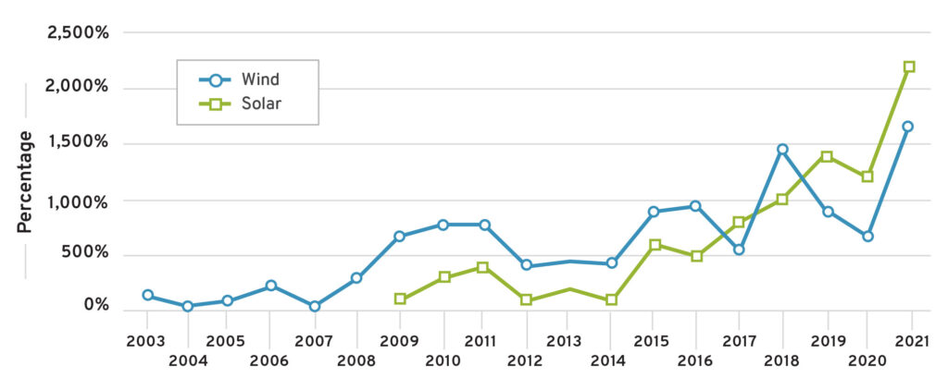
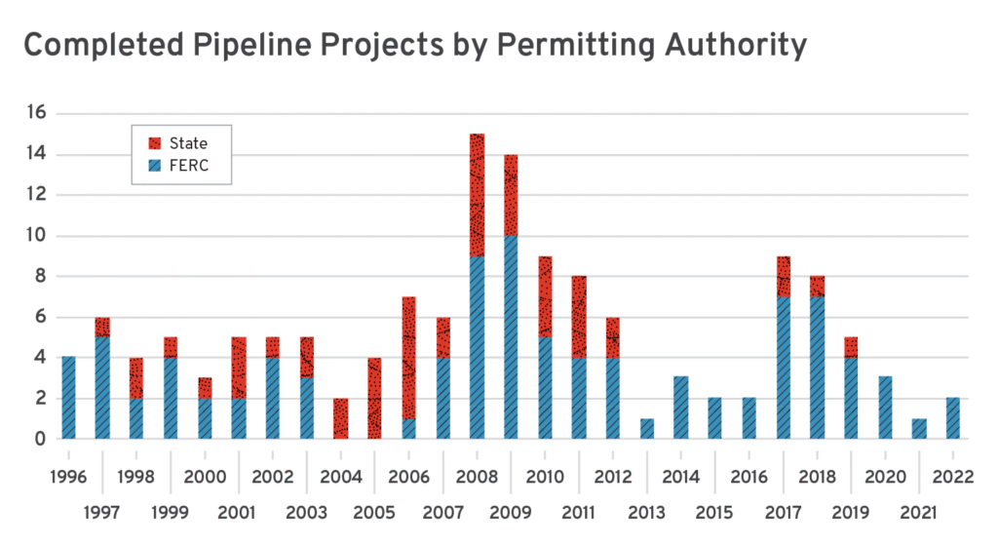
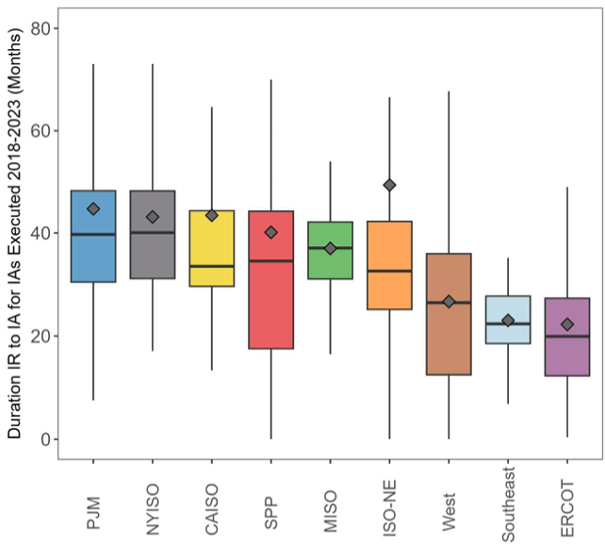
Entry Barriers
Permitting & siting
States: biggest barriers, neg trend
Fixes: tie restrictions to demonstrated harm, better information, appeals process for property owners, tech-neutral leg/process
Fed: exec. heavy, mixed trends
Fixes: litigation risk, predictable, permanent
Interconnection
Top-push vs. bottom-up reform
Fixes: best study & mngnt practices, info tools, non-discriminatory fast-tracking, simplify deliverability, proactive Tx planning
Percent Change in Annual New Ordinances (Start Yr Indexed)
Interconnection Delays
Sources: R Street DOE comments, Consumer Interconnection letter and State Permitting series and paper. Clean Tomorrow state siting 2025 paper.

Slide 7

Thank you!
Devin Hartman
dhartman@rstreet.org
www.rstreet.org

Slide 8
Appendix

Slide 9
Cost-Focused Instrument Choice
Policy Framing
Cost ≠ price
Goal: prices reflect fundamentals
Diagnose cost drivers correctly (e.g., PJM)
Remedy artificial costs
Remedy competitive conditions
Avoid
Price controls: deter low-cost entry & OpEx
Subsidies: shift but do not lower costs, deter cost-cutting efficiencies, add deadweight loss
Reform
Artificial barriers to entry/exit (e.g., permitting)
Artificial market power (e.g., cost-of-service)
Enhance competition: (e.g., transparency and efficient market power mitigation)
E.g., Interconnection Delays

Slide 10
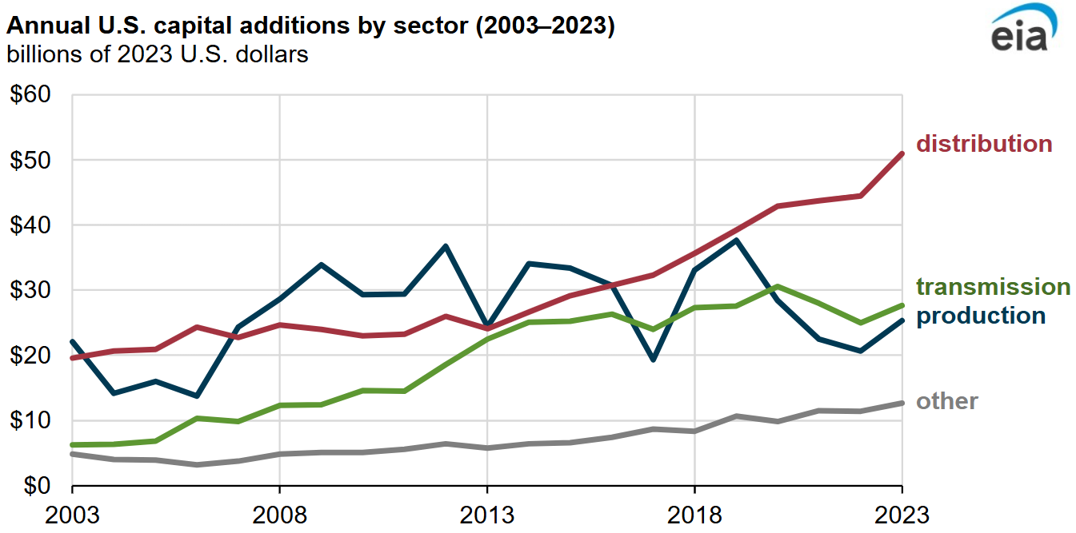
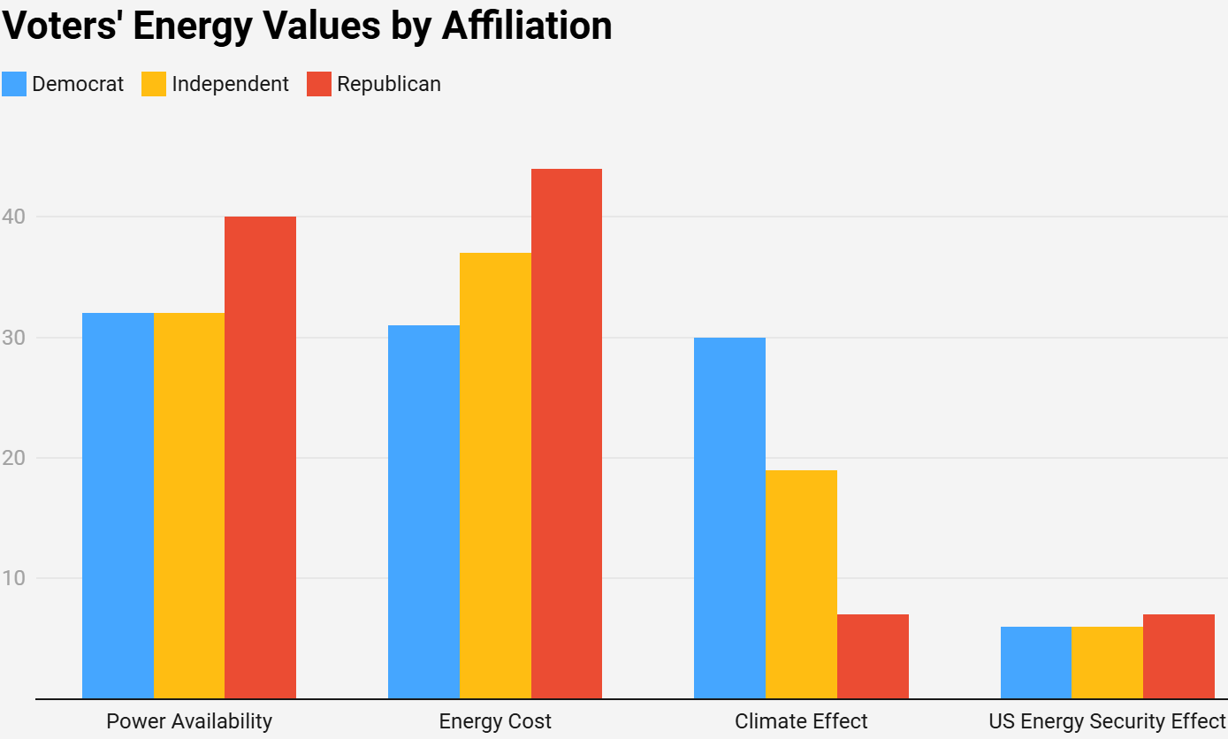
Cost-Conscious Power Reforms
Accurate load forecasting
Economical T&D
Efficient markets
Wholesale & retail competition
Low entry/exit barriers
Permitting/siting
Interconnection
Legacy gen policy
Cost-minded emissions pivot
Negative & low-cost abatement
2-4x gen entry time inc.
Artificial barriers + supply chain delays
For greater detail see R Street comments to DOE on Speed to Power. See also R Street & PPI via FAS paper on “Cost Come First in Reset Climate Agenda”. EIA source.

Slide 11
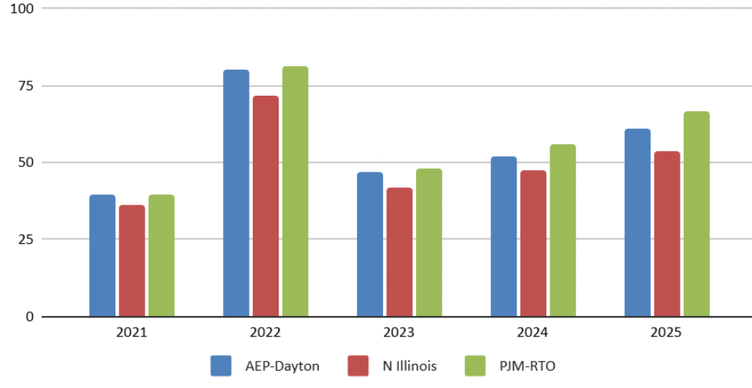
Smart Money Trends
Forward prices < implied utility forecasts
18-month forward ave. for each given year, e.g. Year 2025 is for the ‘July 2025 - Dec 2026’ forward period.
Sources: R Street using S&P Power Forwards & Futures Data

Slide 12
Load Forecasting Uncertainty
Retail errors → wholesale problems
Methods & sources
Accuracy options:
Load collateral req.
Indep. forecasting
PUC oversight
PUC-FERC coord.
Sources:
PJM & Jeffries LLC (2025)
E3 (2025): Balancing Risk and Growth

Slide 13

Markets > CoS Regulation
Both models attract capital
Market cost advantage:
Generation OpEx, CapEx, innovation
Retail cost, product innovation
C&I market access movement
Econ profile more market conducive
Market improvement:
Governance, E&AS market design
Capacity procurement rules
Retail hedging, transparency, education
“wholesale competition worked as intended…easy entry and exit markets of ERCOT, California, and the Northeast, and much more slowly in the vertically integrated Midwest, West and Southeast.”
2017 DOE Reliability Report lead
Sources: Bushnell (2017) restructuring economics lit review; Yozwiak (2025) “Gold-Plate or Glint” paper; Hibbard (2023); R Street Electric Paradigms paper (2023); Silverstein (2017) in UtilityDive

Slide 14
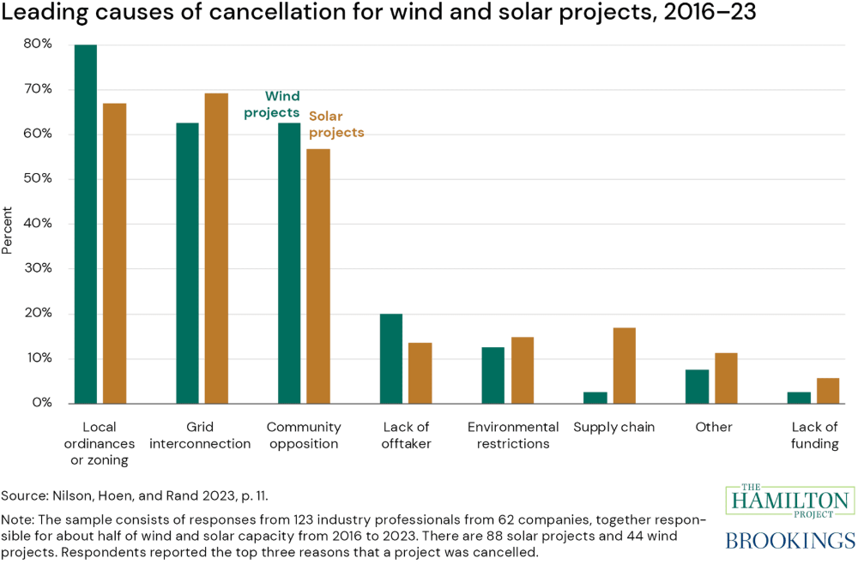
Source link.

Slide 15
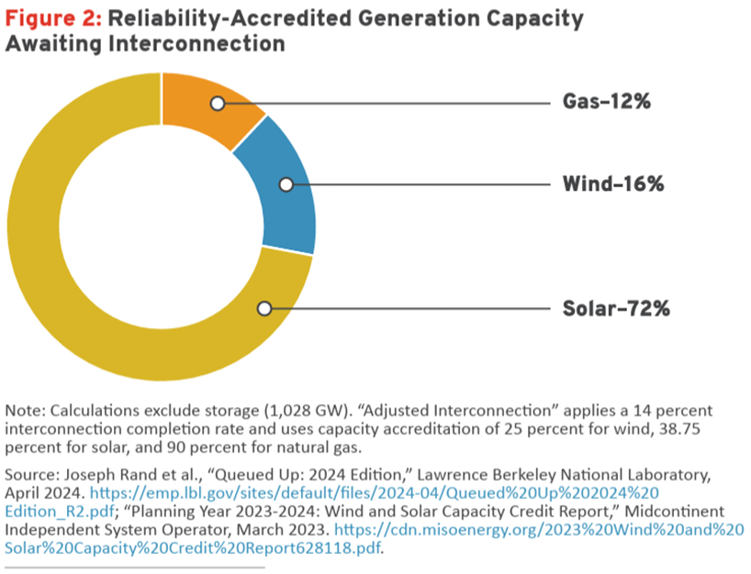
Generation Post-OBBBA
S&P: “Risk—not capital—is the constraint on wind and solar PV [photovoltaic] growth. A wide range of major players across the energy and finance industries have indicated no change to investment strategies—including investment in wind and solar PV—amid the dramatic change in tone from the US government, removal of climate-specific languages from websites, and select high-profile shifts, such as BP’s pivot back to fossil fuels.
This largely tracks with our understanding that considerable capital desires to invest in clean energy because it has market value even without subsidization. While we anticipate that less subsidy will consequently reduce investment, it is important to appreciate that other factors driving investment and the uptake of clean energy are still at work.”
Source: 2025 S&P Global and R Street Reliability Priorities paper.

Slide 16
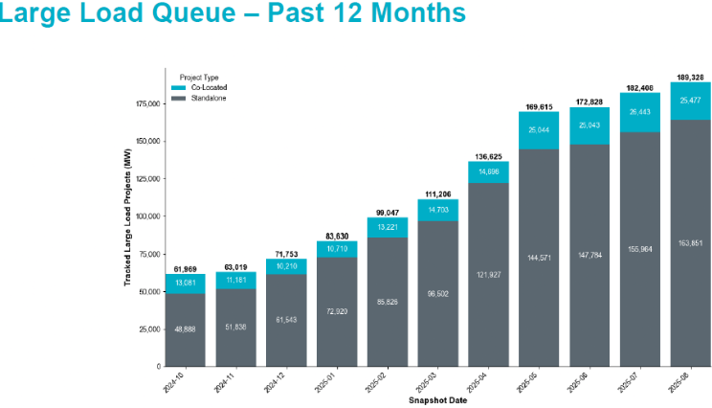
ERCOT Case
Most load-growth ready state
Market design improvements
Large load rulemaking
Transmission expansion
Dispatchable reliability service reserve
½ of requested load materialized
Source: ERCOT Large Load Update (Aug 2025)

Slide 17
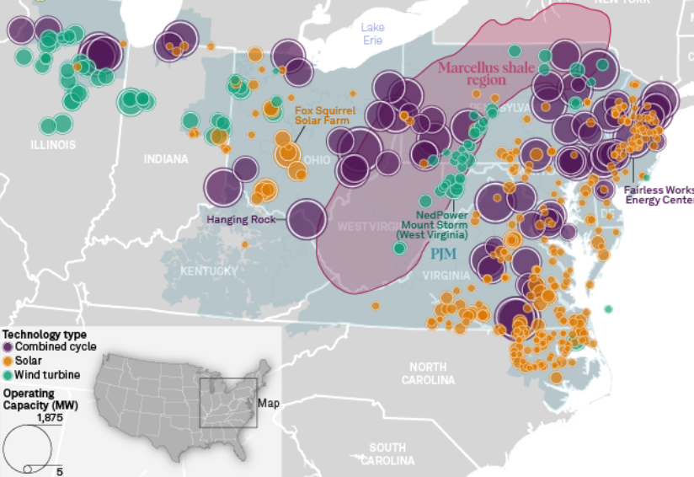
PJM Case
2010s:
Combined cycle revolution
Sufficient IRRs, capital efficiency
2020s:
Entry barriers: state permitting/siting + interconnection + supply chain backlogs
Market price < CoS utility self-supply
Initial under-forecasted load growth
Now over-forecasted load growth
Market retains economic legacy plants
“Rising PJM capacity prices lift returns for all assets”
2-4x gen entry time inc.
Sources: Kennedy & Hsieh 2018; PJM 2016 “Resource Investment in Competitive Markets” ; R Street (2024) PJM auction analysis
S&P Global Market Intelligence (2024) PJM analysis

Slide 18
Generation Retirements Policy
Barriers to exit → barriers to entry
Flimsy emergency actions harm reliability
Reliability (RMR) refinements
Voluntary agreements → state shutdown reconciliation
Market design to min RMR need
Clear, transparent reliability criteria (no RA standard basis)
Dispatch ≠ reliability need
Prevent RMR abuses
Action plan to alleviate the need
Market participants need clear forward expectations
Mutes price signals
Minimal market distortion

Slide 19
Reliability Priorities
Recommendation | Reliability Value | Impact Expedience | Considerations
Generator Winterization | High | Fast | Expedite planned changes.
Nat Gas Fuel Assurance | High | Fast | Remedy gas incentives; new reg authority unnecessary.
Flexible Demand | High | Intermediate | Most load shed events avoidable by curtailing low VOLL.
Generator Interconnection | High | Intermediate | Prioritize reforms of the consumer coalition.
Premature retirements | Medium | Fast | Avoid creating barriers to entry by muting price signals.
Wholesale Market Design | Medium | Intermediate | Ensure reliability-compatible incentive structure.
State Resource Planning | Medium | Intermediate | Balkanized IRP needs to reflect regional conditions.
Conventional Transmission Expansion | Medium | Slow | Reliability value and planning void greatest at interregional scale.
Existing Transmission Expansion | Medium | Fast | AI Action Plan priority. Requires cost-of-service reg.
Institutional Coordination | Medium | Intermediate | Reliability institutions lack external policy influence.
Federal Permitting & siting | Medium | Intermediate | Congress, select fed agencies, EO compliance.
State Permitting & Siting | High | Intermediate | Interstate implications of state policy. Fed coordination.
Source: R Street Reliability Priorities Paper

