Slide 1

Impacts of Regulations & The Inflation Reduction Act
DOE Briefing
Aug. 20, 2025

Slide 2
Pre-IRA Landscape
S&P (2022): “energy grid in its current state is nowhere near capable of handling even a fraction of this incoming variable generation”
S&P Source: https://www.capitaliq.spglobal.com/web/client?auth=inherit#news/article?id=72172110&KeyProductLinkType=6
Graph source: R Street analysis with data from Lawrence Berkeley Lab and the U.S. Energy Information Administration.

Slide 3
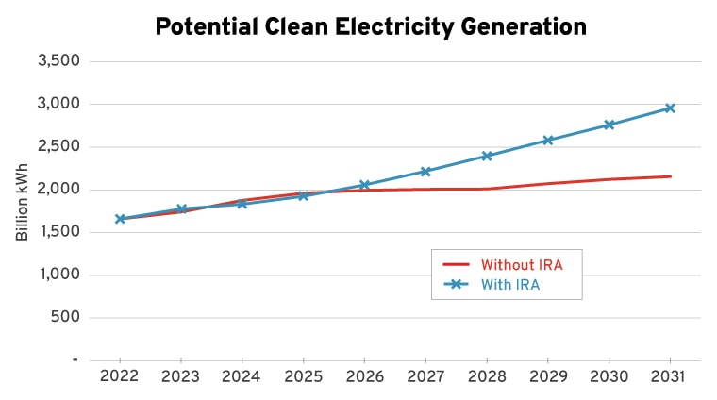
Prospective IRA Impact
Wind & solar financing (67-90% wealth transfer)
  Additionality: storage, clean firm (shifts tech choice)
Pro-IRA studies errors: did not model reality (appendix)
  Renewables: permitting & regulation constrained
Source: 2022 R Street assessment and 2022 and 2023 R Street Congressional testimony.
Modeling reality: https://www.rstreet.org/2022/08/09/think-the-inflation-reduction-act-is-a-climate-savior-think-again/

Slide 4
Recent IRA Evaluations
2023 EIA projections of capacity growth assumed large increase attributable to IRA subsidies.
2025 AEO shows far lower growth in renewable capacity; much closer to the “no-IRA” scenario from 2023, hinting at reduced effectiveness of subsidies.
EIA still projects large effect from subsidies in medium and long-term, despite strong evidence of overestimating near-term impacts.
Sources: EIA Annual Energy Outlook (AEO) 2023 and 2025

Slide 5
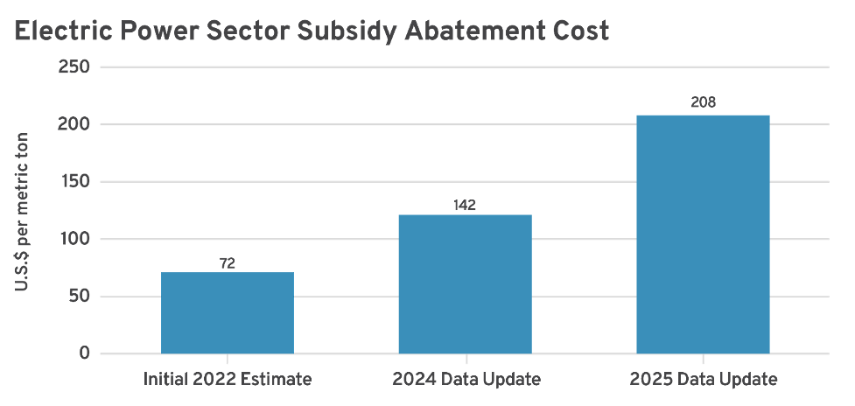
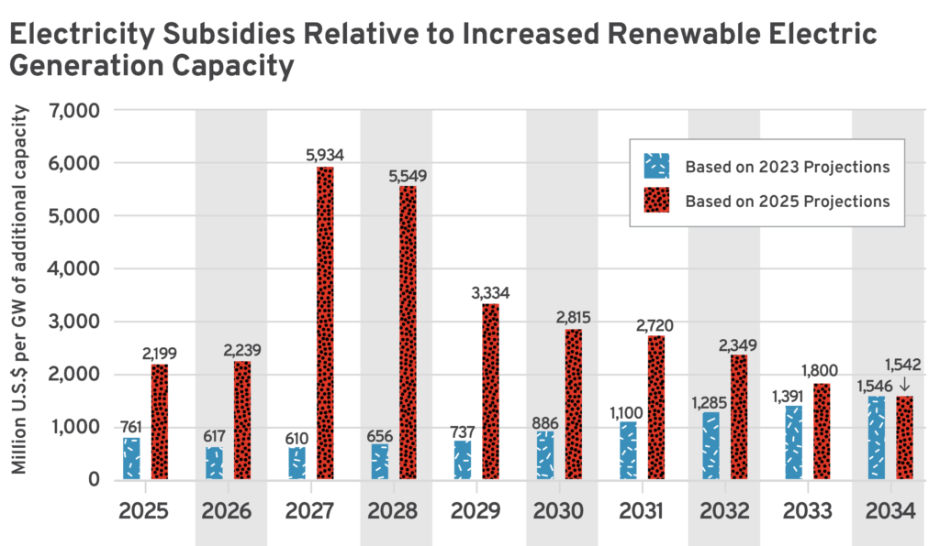
Recent IRA Evaluations
Source: two R Street July 2025 assessments

Slide 6
Post-OBBBA
S&P: “Risk—not capital—is the constraint on wind and solar PV [photovoltaic] growth. A wide range of major players across the energy and finance industries have indicated no change to investment strategies—including investment in wind and solar PV—amid the dramatic change in tone from the US government, removal of climate-specific languages from websites, and select high-profile shifts, such as BP’s pivot back to fossil fuels.
This largely tracks with our understanding that considerable capital desires to invest in clean energy because it has market value even without subsidization. While we anticipate that less subsidy will consequently reduce investment, it is important to appreciate that other factors driving investment and the uptake of clean energy are still at work.”
Source: 2025 S&P Global.

Slide 7
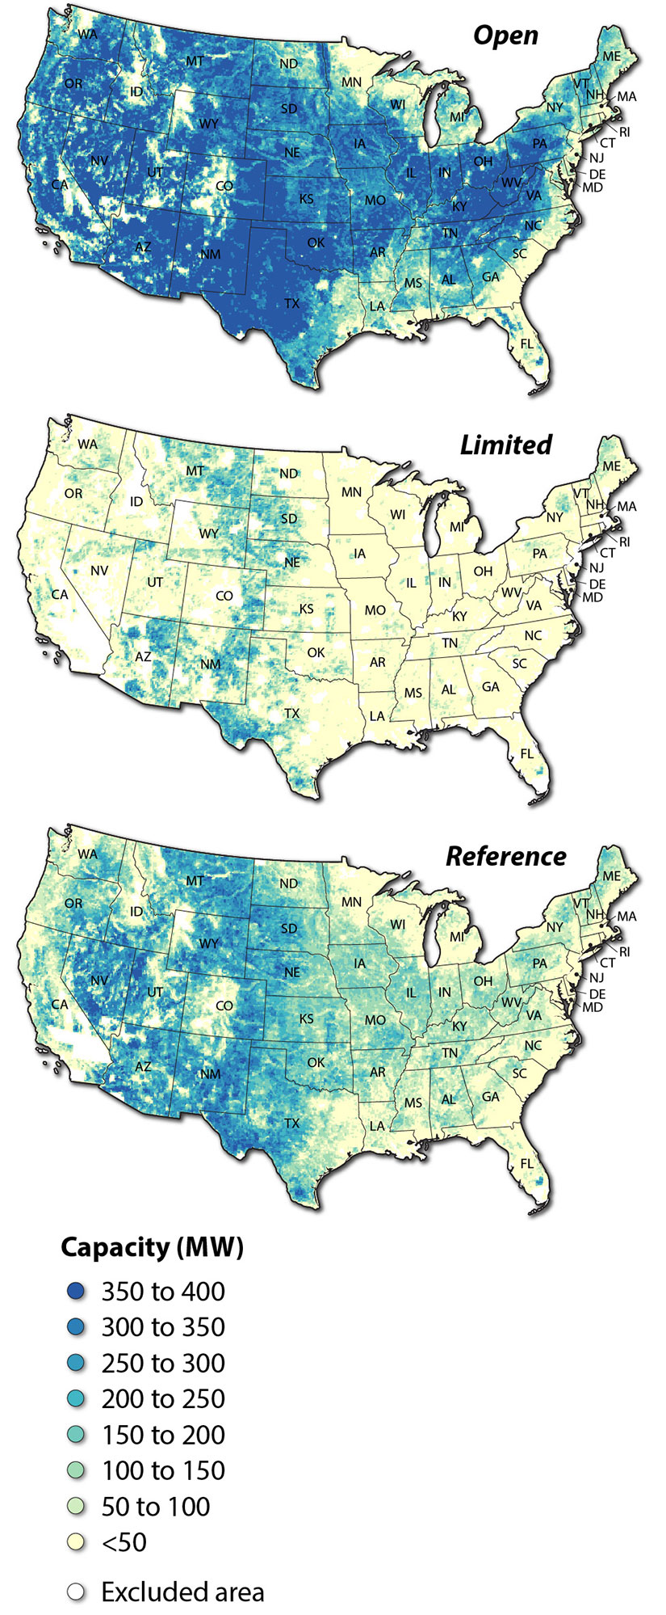
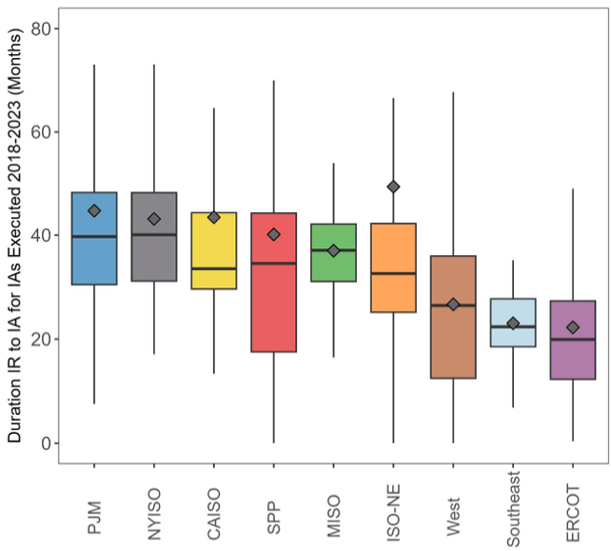
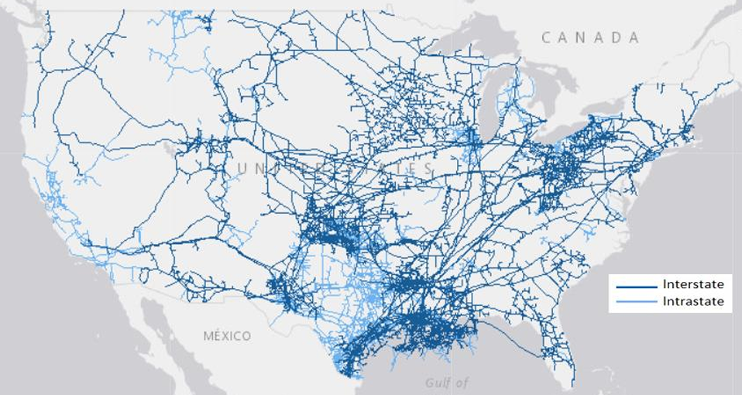
Back to Cost & Reliability
Wind Ordinances
Incomplete electricity markets
Mounting barriers to entry
Uneconomic gas & elec transmission status quo
Interconnection Delays
Natural Gas Transmission Pipelines

Slide 8
Reliability Priorities
Recommendation | Reliability Value | Impact Expedience | Considerations
Generator Winterization | High | Fast | Expedite planned changes.
Nat Gas Fuel Assurance | High | Fast | Remedy gas incentives; new reg authority unnecessary.
Flexible Demand | High | Intermediate | Most load shed events avoidable by curtailing low VOLL.
Generator Interconnection | High | Intermediate | Prioritize reforms of the consumer coalition.
Premature retirements | Medium | Fast | Avoid creating barriers to entry by muting price signals.
Wholesale Market Design | Medium | Intermediate | Ensure reliability-compatible incentive structure.
State Resource Planning | Medium | Intermediate | Balkanized IRP needs to reflect regional conditions.
Conventional Transmission Expansion | Medium | Slow | Reliability value and planning void greatest at interregional scale.
Existing Transmission Expansion | Medium | Fast | AI Action Plan priority. Requires cost-of-service reg.
Institutional Coordination | Medium | Intermediate | Reliability institutions lack external policy influence.
Federal Permitting & siting | Medium | Intermediate | Congress, select fed agencies, EO compliance.
State Permitting & Siting | High | Intermediate | Interstate implications of state policy. Fed coordination.
Source: R Street Reliability Priorities Paper

Slide 9
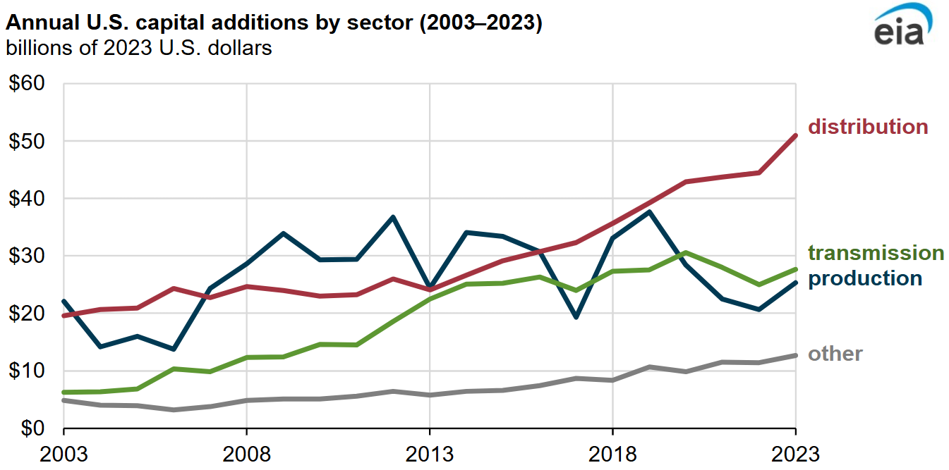
CapEx Drivers
Source: EIA.

Slide 10
Transmission Reform
Consumer Principles
Right-of-Center Principles (draft)
Upgrade existing system.
  AI Action Plan priority
Remove merchant barriers.
Use econ principles for planning & cost allocation.
  e.g., CBA, beneficiary pays, competitive bidding,
Streamline permitting/ siting.
  AI Action Plan priority
Improve governance.
Full report: https://www.rstreet.org/2022/05/11/transmission-reform-strategy-from-a-customer-perspective-optimizing-net-benefits-and-procedural-vehicles/

Slide 11

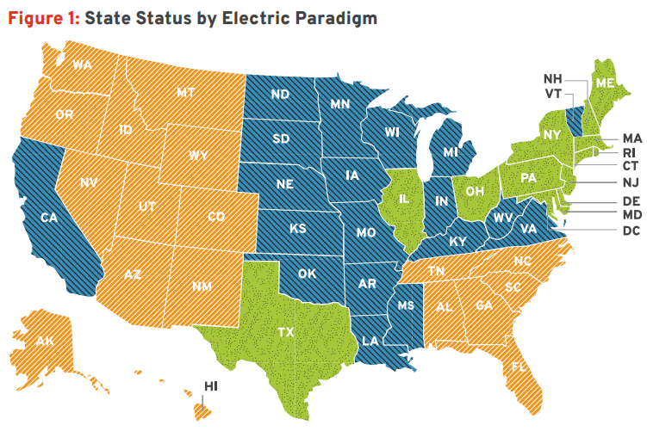
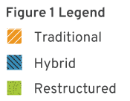
Load Growth Readiness
ERCOT enters 'new era' as grid demand is poised to double by 2030
Wholesale competition
Retail competition
Efficient permitting/siting
  Esp. state level
Efficient interconnection
Economical transmission
Source: R Street paper

Slide 12

Thank you!
Devin Hartman
dhartman@rstreet.org
Philip Rossetti
prossetti@rstreet.org
www.rstreet.org
Twitter: @DC_Hartman

Slide 13
Appendix

Slide 14
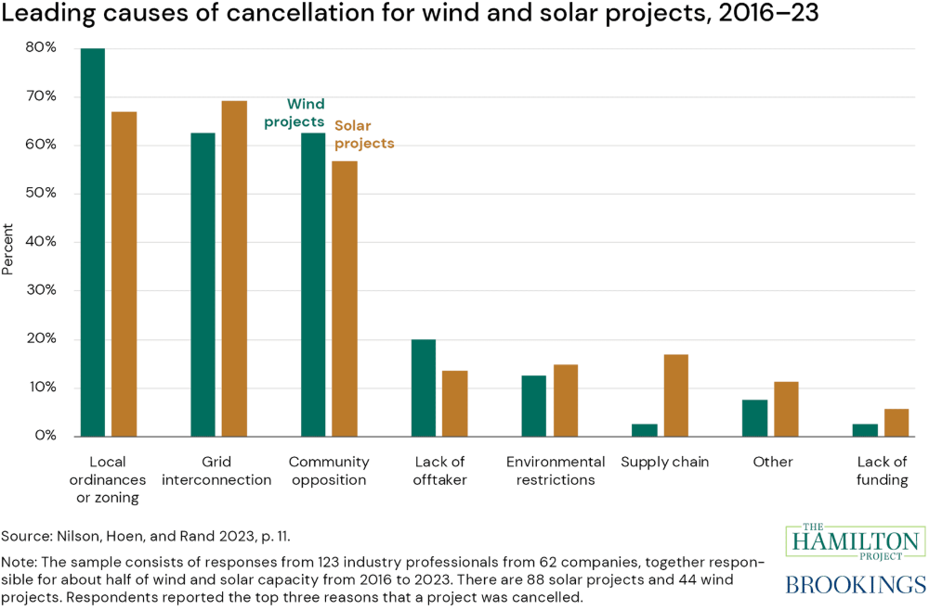
Source link.

Slide 15
Inaccuracies in IRA Assessments
Prominent modeling grossly overestimates IRA additionality
  Practitioners: binding constraints tied to regulatory conditions
Informative studies must model reality:
  Private clean premium (alters baseline)
  Actual and planned generation and transmission expansion
  Transmission congestion & generator curtailment patterns
  Generator interconnection conditions
  Anticipated permitting and siting timelines & costs
  Market rules and reliability standards evolution
  Granularity of effects: regional, except state level for siting
Source: https://repeatproject.org/docs/REPEAT_IRA_Prelminary_Report_2022-08-04.pdf
See more: https://www.rstreet.org/2022/08/09/think-the-inflation-reduction-act-is-a-climate-savior-think-again/

Slide 16
IRA Deployment Effects
Primary: shifts financing for destined projects
  Most beneficiaries are projects already planned
  Vertically integrated utilities benefit most (infrastructure act funds and tax credits advantages)
Secondary: marginal additional mature tech projects
  Tips some storage > gas peakers
Tertiary: additional uneconomic (nascent tech) projects
  E.g., de-risks demonstrations
Key deployment variable: regulatory environment
  w/ or w/o IRA
Ignoring reg constraints, 67% of clean energy backed by IRA would have occurred anyhow. Actual number likely 80-90%.
BoA:
1) Renewables accelerate in least efficient areas
2) More price volatility & load balancing challenges
BoA source: https://www.utilitydive.com/news/inflation-reduction-act-clean-energy-boa-bank-of-america/631608/
Notes:
Renewables locate where CFs are low

