Slide 1
Ukraine, Energy, Climate and Electricity Markets
Harvard Electricity Policy Group
May 5, 2022

Slide 2
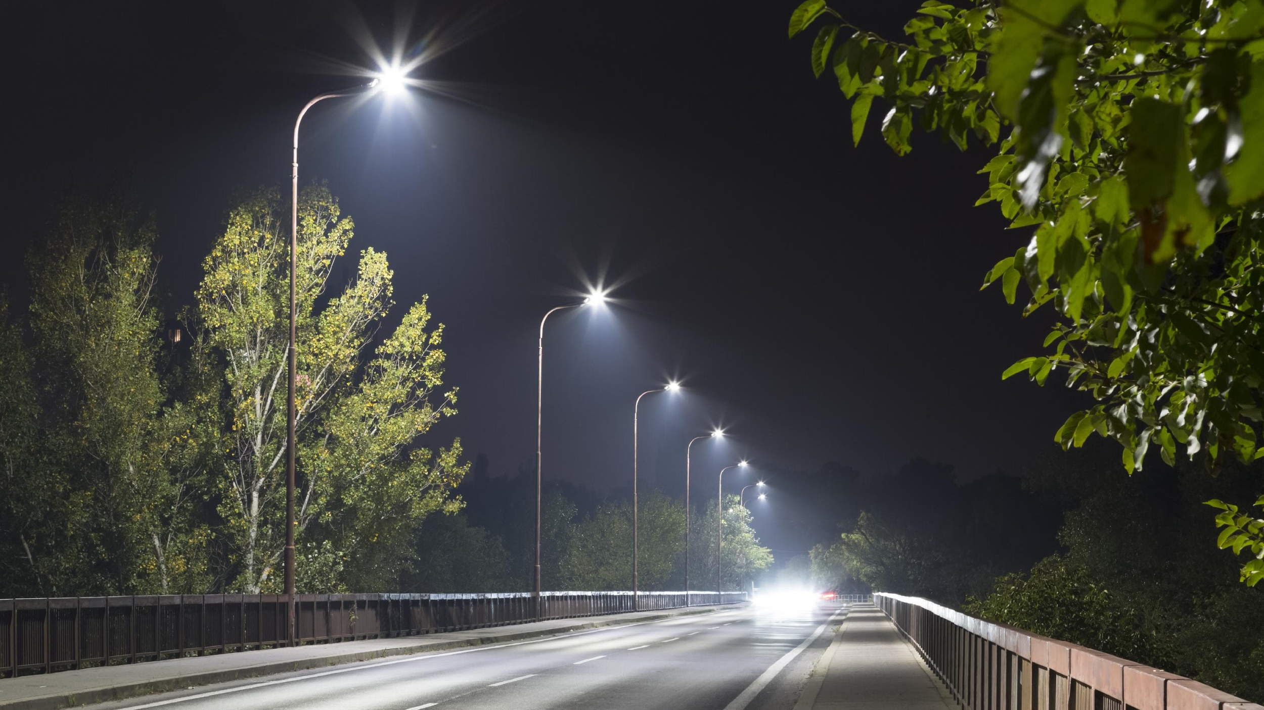
WHO WE ARE
R Street Institute is a nonprofit, nonpartisan, public policy research organization. Our mission is to engage in policy research and outreach to promote free markets and limited, effective government.
Victories at the Margin
Deep Expertise
Broad Coalitions

Slide 3
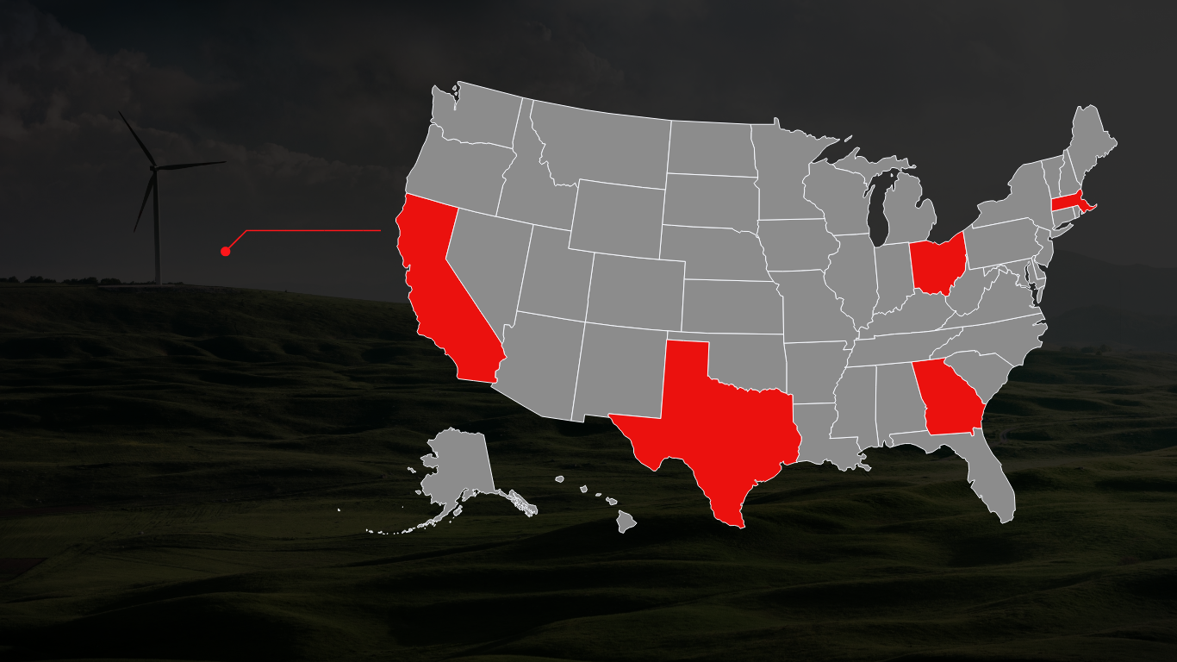
WHERE WE ARE
In addition to our D.C. headquarters, we have offices in Georgia, Texas, Ohio, California and Massachusetts.
Denotes Energy Staff

Slide 4
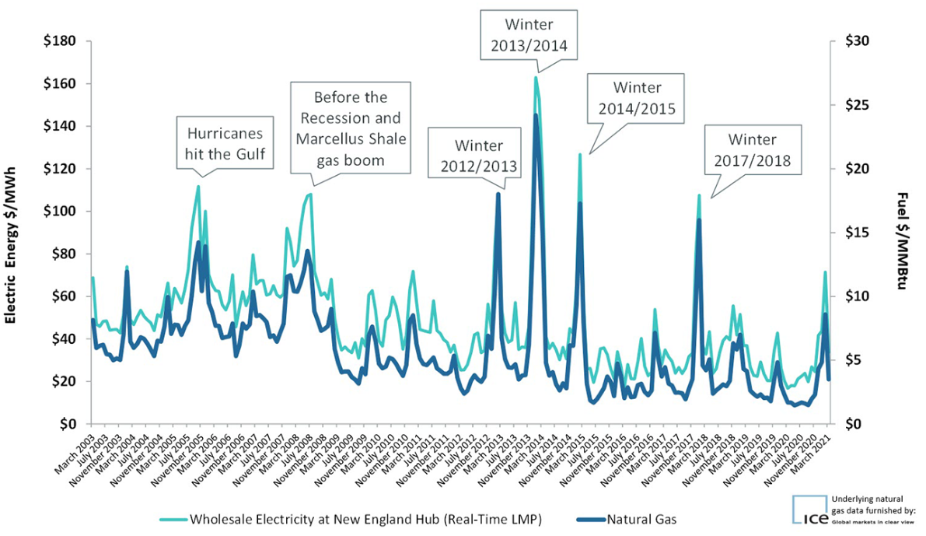
Economics & Politics
Goal: markets account for climate & energy security risks
Stakeholder capitalism era
Political challenges
Prices signal substitutes vs. politics picks winners
Efficient prices vs. price spike unpopularity
Global lifecycle GHG vs. domestic lens
Remedy: healthy markets
Risk transfer (moral hazard)
Define/secure property rights
Information symmetry
Low entry/exit barriers
Low transactions costs
Internalize externalities
New England Gas & Electric Prices
See https://www.iso-ne.com/about/key-stats/markets
https://www.rstreet.org/2022/03/23/healthy-markets-remedy-energy-and-climate-crises/
Notes:
[Europe, Texas, New England price charts/headlines]
Political love/hate of commodity markets linked to marginal costs

Slide 5
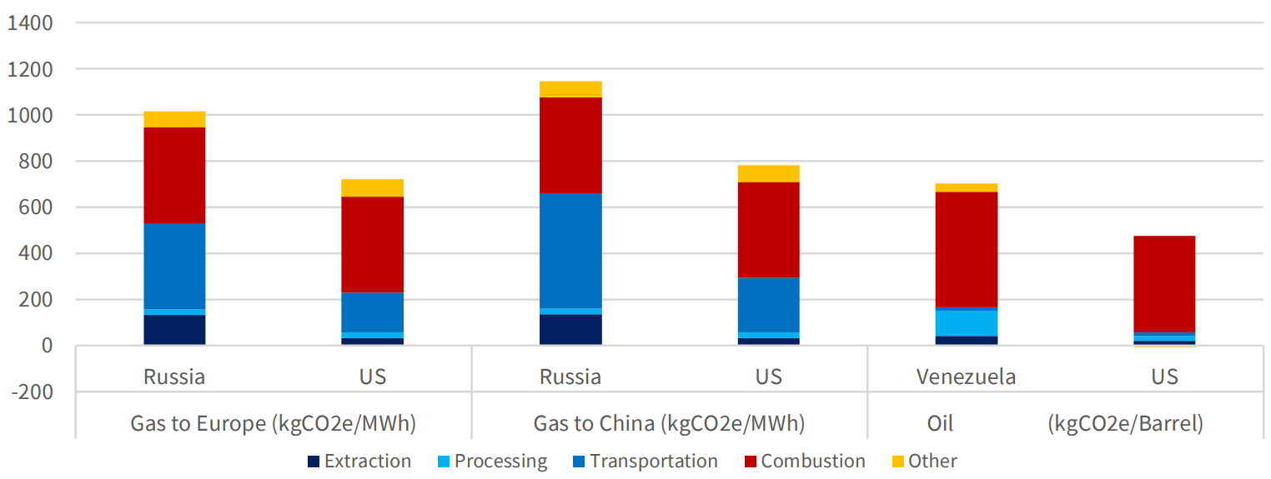
Natural Gas Schizophrenia
Domestic politics meets global reality, local reliability
Climate or reliability? FERC blocks Northeast gas project
Sources:
Coefficient https://co2efficient.com/methane
E&E News: https://www.eenews.net/articles/climate-or-reliability-ferc-blocks-northeast-gas-project/
CRES Forum, Carnegie Endowment for Int’l Peace, NETL: https://cresforum.org/wp-content/uploads/2022/03/U.S.-Fossil-Fuels-Should-Play-a-Crucial-Role-in-Reducing-Global-Emissions.pdf
UtilityDive: https://www.utilitydive.com/news/manchin-barrasso-ferc-gas-infrastructure-pipeline-review/619816/

Slide 6
Stable Climate + Secure Energy
 | Do | Do Not | Context
Market Institutions | Integrate gas globally. Expand RTOs, restructure. | Inhibit trade. Socialize risk. | Liquid+fungible markets, supplier assigned risk.
Entry/exit Barriers | Depoliticize, streamline permits. Market design, interconnection. | Micromanage permits. Creative RMRs. | Envir. permitting often retards net envir gains.
Risk Management | Credit/collateral and hedging requirements. Supply chain risk alignment, ISACs. | Price controls. Emergency actions for structural risk, eg DPA. | Manage econ & political risk of price spikes w/o muting signal.
Market Power & Manipulation | Refine elec & gas mitigation. Clarify manipulation. | Inhibit nodal congestion products. | Chilliness dries liquidity. Phys withholding probs.
Environmental Transparency | Granular emissions visibility. Climate reporting guidance w/ private ordering, int’l sync. | Create new liabilities. Deter reporting quality. | Remedies info deficiencies.
Product heterogeneity | Validate envir & reliability differentiated commodities | Misdiagnose greenwashing. | Remedies property rights & high transactions costs
Emissions Pricing | Tax bads, not goods | Asymmetric application. Refund schemes. | Long-term tax revenues increase for debt relief
Notes:
Markets won’t deliver what policy won’t allow

Slide 7
High Impact, Low Probability Events
PROBABILITY
Risk Management Policy
Known
Gov’t Failure > Market Failure
Uncertainty Management Policy
Unknown
Low
High
MAGNITUDE OF CONSEQUENCE

Slide 8
Electric Uncertainty
Revisit resilience economics:
Avoid ad hoc, premature reforms.
Conceptual understanding from end-user perspective.
Economic framework to evaluate bulk power resilience.
Tailor reforms to degree of regional heterogeneity.
Applications:
Reliability metrics & standards reform
Frequency → add duration
Engineering heuristics → social welfare
Differentiated firm service reliability
Transmission planning
Capacity market design
e.g., scenario-based accreditation & zone definitions
DER policies
Climate disasters have rendered ‘one-in-10’ grid standard obsolete, experts say
See https://www.rstreet.org/wp-content/uploads/2018/05/Resilience-Reply-comments-May-2018-FINAL.pdf

Slide 9
Thank you!
Devin Hartman
dhartman@rstreet.org
www.rstreet.org
Twitter: @DC_Hartman

