Slide 1

Rate Design in a 100% Clean-Energy Transition
Travis Kavulla
Director, Energy & Environmental Policy
R Street Institute
Advanced Rate Design Workshop
Honolulu, Hawaii
July 15, 2019

Slide 2
Consider the Source
Director, Energy & Environmental Policy, R Street Institute
Governing Body Member, Western Energy Imbalance Market
Formerly “The Honorable Travis Kavulla”: utility commissioner (State of Montana) and past president, National Association of Regulatory Utility Commissioners (NARUC)
The views expressed here are mine alone.

Slide 3
Rate Design:
Why should regulators care?
Bad rate design leads to individuals taking actions that may be privately profitable— but which may raise the cost to society to provide a reliable, clean supply of energy
  Example #1: Demand charges that lead batteries to be deployed for a siloed use (keeping individual consumer’s demand below a certain threshold), rather than for system purposes
  Example #2: Supply rates that overstate marginal cost of energy, and lead to uneconomic entry of distributed energy resources
Good rate design can allow demand to play an essential role in integrating a system dominated by renewable energy

Slide 4
Cost structure in a jurisdiction moving toward ‘100%’
Hawaii is not going green overnight, but it will happen relatively fast. The 25-year trajectory implies a few things are likely to happen:
  Fuel costs (variable costs) will diminish.
  Overall capital investment (fixed costs), whether HECO-led or customer-led, will increase.
  There will be more periods where the system will be oversupplied, and (unless overbuilt) there will also be more periods where energy is scarce.

Slide 5
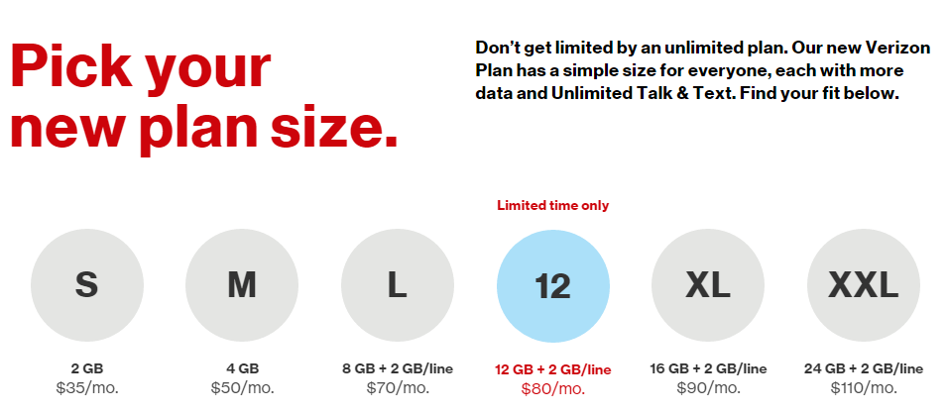
Rate Design at a ‘100%’ renewable end state?
If short-run variable costs were zero, customers’ electricity should probably be paid for like the smartphone than the gas station fill-up
It’d probably also look like the cell company in terms of system congestion management (e.g. “throttling”)

Slide 6
But moving to ‘100%’ poses tricky questions on rate design
Do we want rate design to send price signals intended to accomplish investment (i.e., do we expect rate design to accomplish IRP/IGP-like objectives)?
As renewables are added, how to reflect the value of energy during the (frequent) periods of vast oversupply and other (hopefully less frequent) periods of scarcity?

Slide 7
Supply Pricing in a Retail-Monopoly Marketplace
If HI had many sellers & buyers → Bid-based wholesale market + security-constrained network → Locational Marginal Prices → inform procurements/sales in a competitive retail environment. This structure gives rise to appropriate supply pricing in larger markets.
Hawaii is not that.
  Its grids are not large and liquid enough to have a workable bid-based wholesale market.
  Many procurements made through a “planning”/RFP process – although LMP-like prices should inform those procurements
A second-best option to obtain accurate, useful supply prices is a “cost-based” market. (Wolak, 2018)*
*Frank Wolak, Stanford University
“How should the Public Utilities Commission regulate the Hawaiian Electric Company for better integration of renewable energy?”

Slide 8
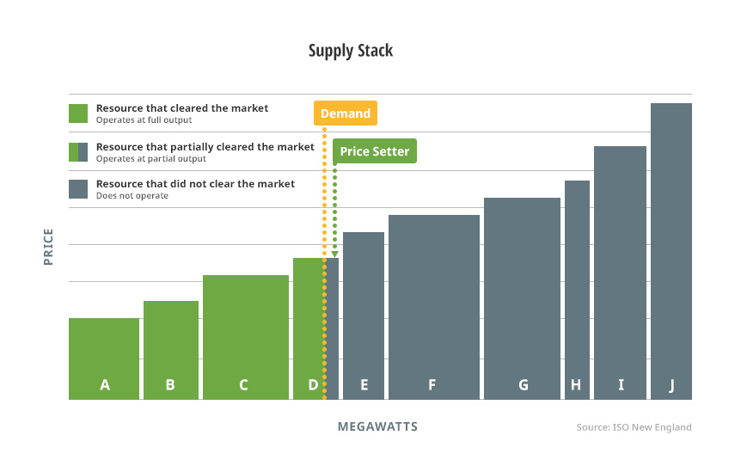
Cost-Based Market
The cost of generator units to HECO is known and approved by regulator, allowing a “supply stack” to be created (periodically modified by outages, fuel price increases, etc.)
A day-ahead market model can estimate consumer load in order to create a day-ahead schedule of supply resources, and a measurement of the locational marginal cost of grid-delivered energy

Slide 9
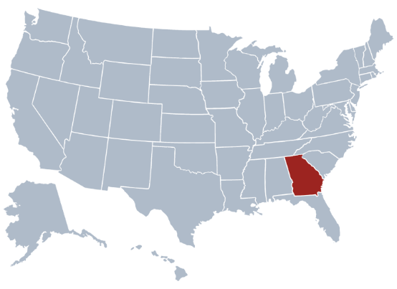

Why a ‘Market’ if HECO is a Monopoly?
Uses a system model to project both a Day-Ahead system (not locational) marginal cost, or λ, for each hour of next day.
Customers “buy” a baseline of usage based on existing rates. They may use more than or less than their baseline usage by paying/being credited λ.
Pro tip: call it a ‘rate design tool’ if you don’t like the word ‘market’

Slide 10
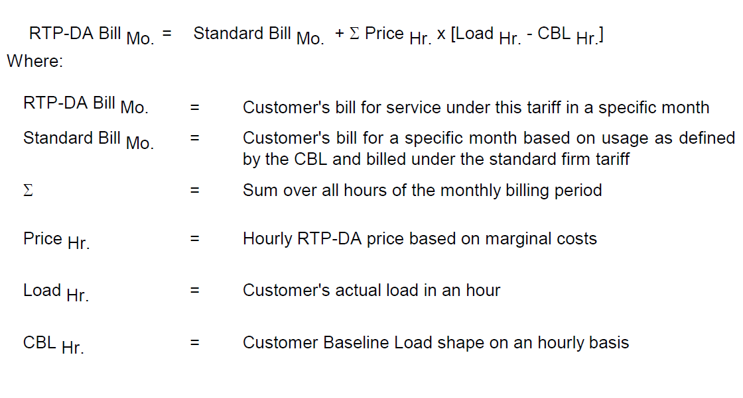
As a formula….

Slide 11
Getting the Baseline Right
The “Customer Baseline Load” (CBL) is important because it is the billing determinant for fixed-cost recovery
Existing Customers
  CBL developed either actual historical metered half-hourly interval data for a customer’s specific location, or
  from a template scaled to the actual historical monthly energy and monthly peak demands
New Customers
  100% of commercial projected load; 60% or greater of industrial customer’s projected load
    Requirement to “demonstrate” actual peak load to avoid gaming

Slide 12
Uses of a ‘Cost-Based Market’
A price within rate design to encourage demand participation: Georgia Power has 2,400 customers on this or its HA dynamic tariff (2/3 commercial; 1/3 industrial)
  Conceivable to have retail aggregators certified and responding to this price signal on behalf of residential customers
Provides DERs a price signal for the economic substitution of offered generation from Day Ahead
The market’s two-part settlement (Day Ahead to Real Time) encourages forward hedging and reliability of supply, because (depending on design of IPP contracts & DER payment schemes) it is an economic resolution to generation & demand imbalances.

Slide 13
Some Possible Objections to this Approach
It’s a 100% renewable system, so it won’t have any marginal costs
  Response: This is a system that is going to have huge excursions of oversupply and scarcity unless & until load is covered in each hour by 100% zero-marginal-cost resources. Is that really going to happen?
  Indeed, it may always have these characteristics (vacillating oversupply and scarcity) if the last increment of supply in scarcer times is price-responsive demand. Which, in a market where the value of lost load < marginal of storage storage, is quite likely.
  A postcard from the future: Imagine a Hawaii marketplace which is more a “reverse curtailment auction” than a “supply the last unit of demand auction”

Slide 14
Objections, Part Deux
The prices won’t rise high enough to get DER built
  Response: Not sure about that!
  In any case, using rate design to organically achieve significant sources of long-term supply in a monopoly market is odd, given that they are “competing” with a central procurer with a tendency to overbuild. Probably better that DER aggregators should sign contracts for energy/capacity obligations to HECO, like IPPs, and be responsible for imbalance in cost-based market’s real-time settlement. (Again, using the “market” as a rate design tool.)
  If you want to “test drive” organic behavioral reactions, then relax the reserve margin in order to drive part of the portfolio to come from voluntary load curtailment/ “merchant” DER.

Slide 15
Finally: A Plea for Regulatory Flexibility
Does every rate need to be spelled out precisely?
In order to get significant DER/DR into a more predictable regime of procurement, there probably needs to be some contractual latitude on the part of HECO to achieve deals that match a customer’s peculiar situation, or which relieve problematic points of congestion on network.
Examples exist of customer protections in a more deregulated regime of rate design (special rates for poor or rural telecommunications customers)

Slide 16
Mahalo…
Questions?
Travis Kavulla
R Street Institute
(406) 788-3419
tkavulla@rstreet.org

